Slide 1
Photographing Roses: understanding and using the New 2017
Ars guidelines and rules
For Exhibitors and Judges. Not Intended To Be A Complete List;
Be Sure to Read the Guidelines before Entering or Judging a Show

Slide 2
Dr Susan Brandt Graham
ARS Accredited Horticulture Judge aRS Arrangement Judge Emeritus
Photographer
Member, First ARS Photography Committee 2012-2018
First PSWD Photography Chairman, 2009-2012
Albuquerque, New Mexico

Slide 3
The American Rose Society’s first Photography Committee, Chaired by Curtis Aumiller and with members Tom Mayhew, Bill Kozemchak, Bruce Monroe (all Penn-Jersey District) and Susan Brandt Graham (Pacific Southwest District) has worked on Guidelines and rules for judging rose photography since 2012.
The ARS Board approved the final version of the first edition in September, 2017
This PowerPoint provides a brief overview of the Guidelines for Exhibitors and Judges.
It is one of a series of presentations on rose photography that can be found at rose.org.

Slide 4
Most People Do Not Read Guidelines for Fun!
(I Don’t!)
The Guidelines are important as a reference that sets standards.
Exhibitors and judges alike need to familiarize themselves with the rules and guidelines before participating in a show.
I hope that by pointing out some of the important points in this final version of the First Edition of the Guidelines and Rules for Judging Rose Photography, our exhibitors and judges will find navigating the guidelines a little easier.
The American Rose Society and the Photography Committee would like for members at all levels to enjoy both photography and roses.

Slide 5
Use of These PowerPoint Presentations
You will find a series of PowerPoint presentations on various aspects of rose photography at rose.org More will be added over time, so check periodically.
Individuals may use them for their own educational purposes.
Local and District societies may download them and use them for educational purposes, for both exhibitors and judges.
They may be used in meetings, as well as in Judging Seminars and Judging Schools.
Commercial use is strictly forbidden.

Slide 6
The most important thing is to have fun with photography and Roses!

Slide 7
The ScoreCard
Please Note Changes Have Been Made Here

Slide 8
New Scorecard and Scale of Points in the 2017 Guidelines
CONFORMANCE ....................................................5
SPECIFIC SECTION .................................................50
COMPOSITION .......................................................15
TECHNIQUE .............................................................15
DISTINCTION ...........................................................15
TOTAL .....................................................................100
These are defined in Section 6 of the Guidelines.
Notes:
Section 5-1

Slide 9
Conformance
5 Points
“This section is for following the rules of the written schedule and the rules of the class in which the photograph has been entered. This is where misplacement in the wrong class may be penalized. Issues with the mounting of the photograph, issues with the matting of the photograph, not disbudding a rose that says in the schedule to be disbudded, and foreign substances would be penalized in this category.”
“Another penalty in this category would be regarding arrangement and seedling photographs. If the arranger is not listed/credited in arrangement photos or the hybridizer is not listed/credited in seedling photographs, then the photo should be penalized.”

Slide 10
Conformance (Cont’d)
Recently an exhibitor noted in a District Newsletter the feeling that some judges were saying all photos should be matted in a specific color. The ARS Rules and Guidelines leave the choice of color up to the exhibitor.
Although it would violate the spirit of the Guidelines, a show could require a specific color of mat ONLY IF THE REQUIREMENT FOR A SPECIFIC COLOR IS SPECIFIED IN THE SHOW SCHEDULE.
If a show schedule did specify a specific color for a mat, an image not matted in that color would be subject to penalization under Conformance. The maximum number of points for Conformance is five (5), so such an image would be penalized only 1-2 points.
I have exhibited photography in juried shows and galleries from New York to California, Buenos Aires (Argentina) to Berlin (Germany). Around the world, the preferred and usually required mat color is white or off-white. Grays and blacks are *allowed* in a few shows in the Albuquerque area, but are never the preferred color.
The ARS has deliberately kept mat color a choice of the exhibitor because our shows are 1-2 days, are in the context of a rose show and not a gallery show, and should be fun and flexible for the exhibitor.

Slide 11
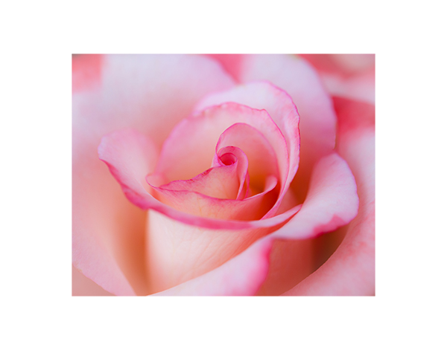
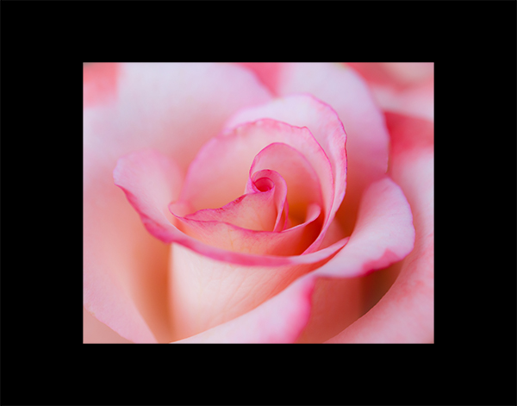
Having Said That, There Is a Reason Why White or Off-White Is the Standard for Mat Color around the World!
‘Gemini’ with White
‘Gemini’ with Black

Slide 12
Composition Requires Some Discussion
COMPOSITION – 15 Points - refers to the arrangement of objects in an image to show rhythm or movement, and guides the eye through a photograph.
Many different compositional principles exist, and these are just a few: Rule of Thirds; Diagonal; Triangle; Golden Ratio; Golden Spiral; Leading Lines; plus many more. What is important is that the eye moves through the photograph. Composition is what guides movement.
Beginning photography judges seem to want to emphasize Rule of Thirds across the board. This is a beginner’s mistake.
Judges should note how the eye moves through the photograph, not whether one specific compositional principle was used.
As an example, rose sprays have a complex compositional rhythm of their own (and it varies between varieties). I nearly always center sprays, so that no artificially imposed photographic composition detracts from the natural rhythm and composition of the spray itself.
Composition of a photograph should be judged by how well the arrangement of objects in photograph guides the eye through the photograph and not by whether one specific compositional principle was applied to produce the photograph.

Slide 13
Some Quick Reference Materials for Composition
Bite Size Tips: 3 Composition Rules Many Photographers Don’t Know
15 Photographs That Make Excellent Use of These Five Composition Techniques
9 Photo Composition Tips, As Seen in Photographs by Steve McCurry
“Remember, the composition is important, but also rules are meant to be broken,” Steve McCurry says. “So the main point is to enjoy yourself while you’re photographing and photograph in your own way and your own style.”
Good advice to follow if rose photography is going to be enjoyable and fun, as it should be!

Slide 14
Technique
Photography, literal from the Greek, “Light Writing.”
LIGHT is the basis of all photography, be it film, digital, wet plate, and on and on.
Good lighting can make up for a lot of faults, and poor lighting can essentially destroy an image well done in other aspects.
Lighting is judged by the degree to which it enhances a subject. It is penalized by the degree to which it detracts from a subject.
Different subjects require different lighting. Landscapes require shadows to add depth to the image. In floral photography, shadows that enhance and emphasize petals, overall form, etc. will result in more points. Shadows that cut across and detract from blooms will lose points under technique.
Practice photographing the same object using different lighting conditions and see which you find most appealing. Reading about and watching videos about lighting is a good start. Actually trying different lighting techniques on the same object will make you a master.

Slide 15
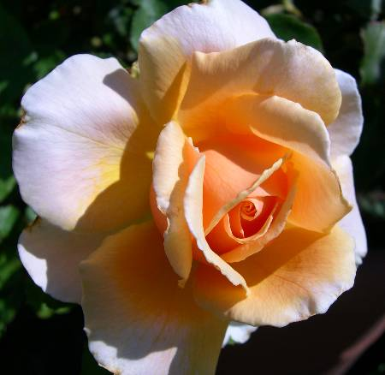
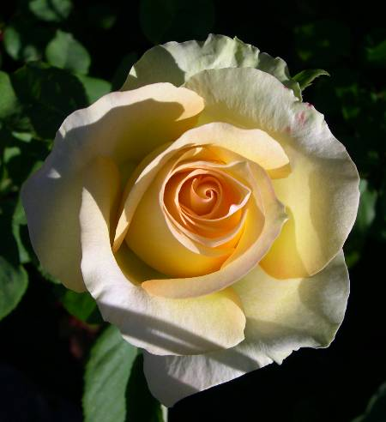
Hybrid Teas with Good Form and Poor Light –
This is Poor Lighting and NOT ‘Dramatic’ Lighting!
Just Joey
(the cut off petal would also receive a deduction)
St. Patrick
Notes:
These are both mine, using a little Nikon Coolpix years ago.
Shadows that interfere with the flow of form are not desirable.
Where points will be lost, using the Score Card, will be in “technique” and “distinction.”
Sally, just out of curiosity, how would you score these?

Slide 16
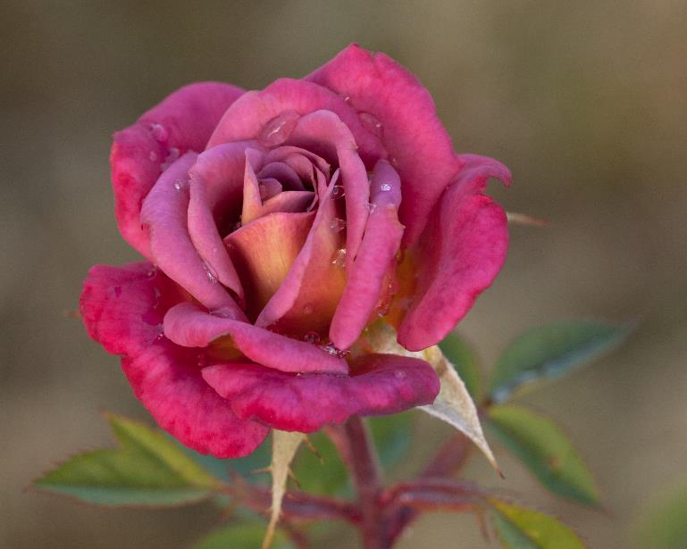
Miniature Rose ‘Incognito’
The form is not as good as that of the hybrid teas in the prior slide.
It has droplets from an overnight rain, which I personally like. The Guidelines read as if water droplets should be avoided at all costs. I will continue to show images with droplets if I find them pleasing. It’s a personal call.
The main thing to note in comparing this slide to the prior one is that the LIGHT enhances the bloom. This is a straight-from-the-camera jpg, cropped.

Slide 17
Technique (Cont’d)
Focus receives a lot of attention in the Guidelines.
It is important that the point of interest in the image be in sharp focus.
Floral Judges need to be aware this does not mean the entire image must be in sharp focus. Many fine art floral photographers use Lensbaby lenses to easily produce blur everywhere but at a specific point. I do not own a Lensbaby lens, but do essentially the same thing with aperture control.
The next two slides have images from 2010 used in a 2012 presentation. They are old and the objects are pears, but the slides make the point about selective focus to highlight points of interest.

Slide 18
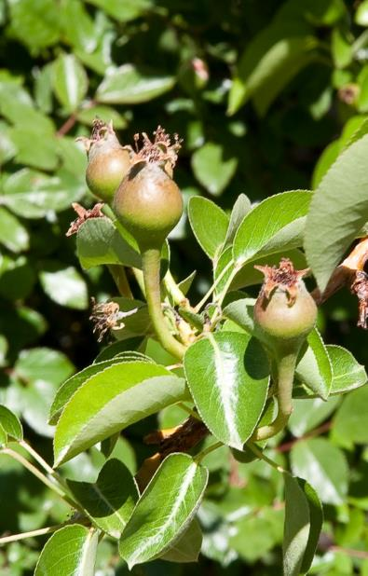
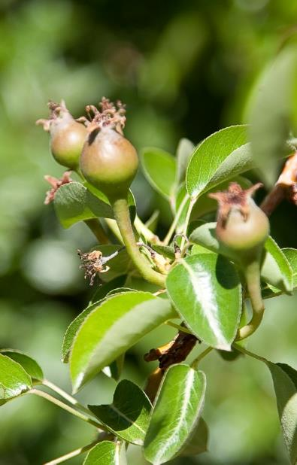
Developing Pears, Taken at Mid-Day
(Not the Best Time for Taking Photographs)
F/22, 1/15 sec, ISO 100, 105mm, pears get “lost”
F/4, 1/640 sec, ISO 100, 105 mm; you see the pears, with the main pear in focus at one of the 4 power points using Rule of Thirds
Notes:
The ARS Rose Magazine contest rules state “Use a small aperture (f11,f16,f22, etc.) to gain more depth of field for most shots…”
I would suggest taking multiple shots at different apertures to see which really works for you.
Both are my images.

Slide 19
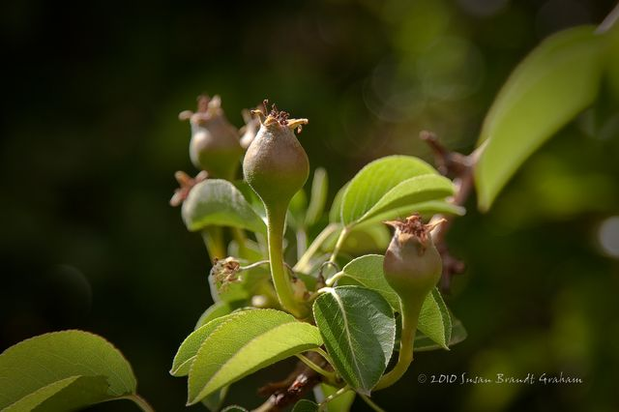
Developing Pears with Main Subject in Focus and Pleasing Bokeh for Background. Taken at Sunset
Notes:
f/4, 1/500 sec, ISO 100, 105 mm
In terms of composition, there is a strong diagonal component, and the two forward pears are each at one of the four “strong points” in the Rule of Thirds.

Slide 20
Miniature Rose ‘Incognito’
Here the point of interest, the center of the bloom, is in focus.
It is also at one of the Power Points using the Rule of Thirds.
The background is completely blurred, allowing the bloom to stand out.
Leaves, a type of “supporting actor” as it were, are visible but blurred, and enhance the bloom.
Photographed in the garden at sunrise.
This is a floral image that I am happy to show to different audiences.

Slide 21
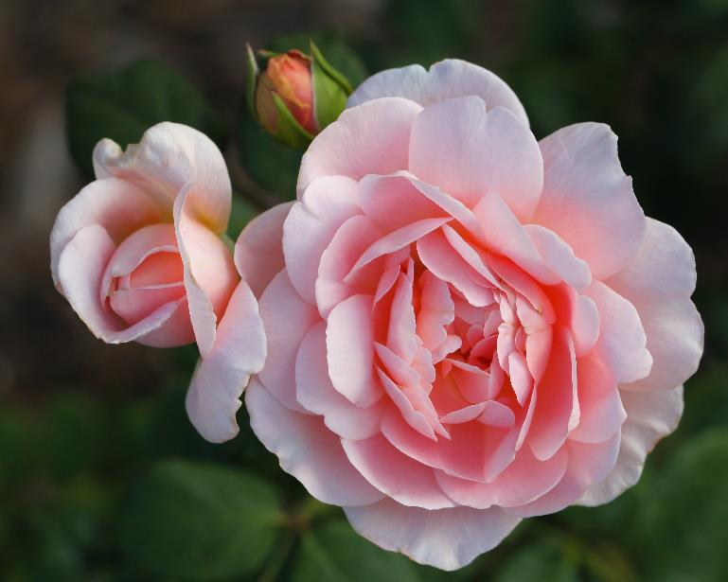
Shrub Rose ‘Ambridge Rose’
Note how your eyes move through this image. This is a variant of Golden Spiral composition.
This was photographed in the garden in evening shade, so there are no harsh shadows cutting across blooms or buds.
Leaves are visible but blurred.
The background is intentionally out of focus.

Slide 22
Distinction
From the Guidelines: “Distinction indicates that everything about the photograph is well done, but in addition, there is something about this photograph that sets it apart from others in its class. Something that at first may be intangible - something we may call the "wow" factor. This includes the presentation of the subject and the composition of the photograph. Is your overall impression a good one? Is the photograph eye catching, and does it attract and hold your attention? Does it draw your eye into the picture, and is your eye led through the photograph to particular points of interest? Is the subject well represented in the photograph?”
To anyone who has judged very many photographs, this is an easy one. You may walk up to a Section, and immediately one image may grab your attention. It has to be judged along with all the other entries. But, at the end of scoring, it is invariably the one that scores high on all points.
If you are fortunate enough to encounter two of those in a Section, they should be point scored meticulously to determine the winner.

Slide 23
Some Changes in sections
Be sure to read the Guidelines and Rules for Judging Rose Photography
Before entering or judging a show.

Slide 24
The Score Card Applies Across All Sections, as Before
The Score Card has been slightly simplified – all the points are in multiples of five – with a somewhat greater emphasis on the specific section: That is:
  The Rose
  The Arrangement
  The Garden
  Macro Photography
  Creative Interpretation
Adjustment to this score card should not be difficult, either for exhibitors or judges.

Slide 25
The Rose
One of the major changes in this section is that dropping petals off the frame or showing only a portion of a bloom is now penalized in an image entered under any of “The Rose” classes. (3-2)
“No matter how the photo is framed, it should not have rose petals cut off at the edge of the photograph. The exception to this would be entries in Creative Interpretation and Macro classes.” (6-4)
Portions of blooms and petals dropped off the frame may be entered either in Macro Photography or in Creative Interpretation, where they are welcome.
Since 2015, images in this section are required to be in color. Black and white, toned, selectively colored, etc. images may be entered in Creative Interpretation. The horticultural sections require color.

Slide 26
The Rose (Continued)
I recently encountered an interesting statement in a District newsletter:
“Who grew that rose or created that arrangement? The rule that the photographer must also be the grower and arranger limits the number of participants in the shows.”
THERE IS NO ARS RULE THAT THE PHOTOGRAPHER MUST ALSO BE THE GROWER OF A ROSE, OR THAT THE PHOTOGRAPHER MUST ALSO BE THE ARRANGER OF AN ARRANGEMENT.
The HIGHEST AWARDS in Photography are Queen, King, and Princess, and these are awarded to the top scoring photographs, regardless of who grew the roses or did the arrangement.
Gold, Silver, and Bronze Certificates are given to the top exhibitor-grown images. This is analogous to the same certificates in Arrangements.
In the Horticulture portion of an ARS rose show, there are no Gold, Silver, and Bronze Certificates, because a cardinal rule for entering in Horticulture is that the exhibitor also grew the rose!

Slide 27
The Arrangement
No real changes were made in this Section.
Exhibitors are reminded that the Arranger must be credited on the entry tag. Entries not crediting the arranger are to be severely penalized under Conformance.
Exhibitors are reminded that the arrangement itself will be judged as it would be in the Arrangement Division of a show. Therefore, the recommendation is that the arrangement be photographed as if one were a judge in the show.
Photographs of arrangements do not have to be of arrangements shown in an ARS show!!! They can be made and photographed anywhere, as long as they follow ARS Arrangement Guidelines, and the arranger is credited.
It is often much easier to photograph arrangements outside of a show!
A PowerPoint presentation specifically on photographing Arrangements may be found at rose.org.

Slide 28
The Garden
As before, this Section has two classes, the Public Garden and the Private Garden.
Also as before, the name of the Public Garden must be identified on the entry tag.
What has changed, is that naming of a Private Garden is no longer a requirement.
If the owner of the garden so wishes, a Private Garden may optionally be named on the entry tag.

Slide 29
Creative Interpretation
This is the section with the most change.
The changes provide many more creative opportunities for the exhibitor.
A separate PowerPoint presentation on Creative Interpretation is a rose.org
“The photograph should demonstrate originality and creativity. This may include processes used to alter the original image such as colorizing, texturing, dodging, burning, dithering, painting, shadowing, blurring, layering, cloning, filtering, merging, cropping. Composites, portions of roses, and roses with petals cut off are allowed in this class. Camera-less photographic techniques such as scanning may be included in this class. Color, Black & White, Sepia, or combinations of these are permitted in this class. Photo enhancement software is permitted in this class. The photographer is allowed and encouraged to utilize the full range of tools and processes to express his or her vision in the creation of rose art.” (10-4)

Slide 30
Creative Interpretation (Cont’d)
Note that portions of roses, and roses with petals cut off (“dropped off the frame”), which are heavily penalized in any classes in the section The Rose, are allowed and welcomed in Creative Interpretation.
Black and white, toned, selectively colored, etc. images are welcome in this Section.
Note that several different classes may be offered within this Section (which is true of other sections as well).
This section provides the most freedom of expression for each exhibitor.
This section is truly intended to provide many opportunities for fun

Slide 31
New Processes and Techniques Are Allowed in “Creative Interpretation” in the 2017 ARS Photography Guidelines
“Creative Interpretation – This is where the exhibitor can allow their imagination to run free. Many times the use of photo editing software for enhancement is utilized in this class. This can range from the use of different filters to color changes to fully composited images to camera-less photographic images such as those created with the use of scanners. The judge needs to remember that actual photographic excellence can also be used in creative interpretation with no use of photo editing software. These types of exhibits should be rewarded. “
Examples of beautiful camera-less photographic images can be seen in the 2017 July/August American Rose Magazine. These were done by scanning.
“Another aspect to remember is that adding words or other images can also be a creative interpretation. Individual rose varieties need not be identified on the entry tag for this class. The creative naming of the exhibit is part of the creative interpretation of the exhibit.”
Notes:
Section 6-3

Slide 32
This Is a Section Where Potentially “Anything Goes,” But Be Sure to Read the Show Schedule
The 2017 ARS Guidelines allow any approach to individual interpretation of “rose art.”
Some show schedules also truly allow any approach to individual interpretation of “rose art.”
However, for example, some schedules may call for specific types of interpretation, such as “abstract” or “impressionistic” images, or “realistic” images, or many other possibilities, which limit the types of creative images allowed in that particular show. Be sure to know the schedule.
Some schedules may have two (or more) classes within this section, allowing for a variety of artistic interpretations of the Rose.
Schedule writers are encouraged to allow for a broad range of creative interpretation of the Rose, including multiple classes where practical and possible.

Slide 33
Macro Photography
Per the Guidelines, “The use of a macro lens alone does not constitute a macro photograph. The terminology of macro is generally used for any type of close up photography. The premise behind macro photography is to take something very small or detailed, and to make it life size. This will usually require the use of a tripod and some practice. The judge must be aware of what the main subject is for the photo and ensure that this main subject is in focus. Outlying areas of the photo may become blurred or fuzzy depending on the size of the actual object being photographed.”
A separate PowerPoint presentation on macro photography is being prepared; watch for it in 2018.

Slide 34
Rose Photography Has Its
First ARS National Challenge Class!
NATIONAL MINIATURE CONFERENCE
PENN-JERSEY DISTRICT NATIONAL AWARD.
An entry of three miniature or miniflora specimens of one variety showing the three stages of development; one bud with petals beginning to unfurl, one at exhibition stage, and one fully open with stamens visible, each stage exhibited in a separate photograph. Each photograph must be mounted and matted with an outside dimension of 11 x 14. Photographs may be no smaller than 5 x 7 and no larger than 8 x 10. Pre-registration is required for entry in this class. Entries are limited to one entry per exhibitor. Entry will be placed by the exhibitor with assistance by the Chair of Photography.
All ARS Photography Challenge Classes are open only to current members of the American Rose Society.

Slide 35
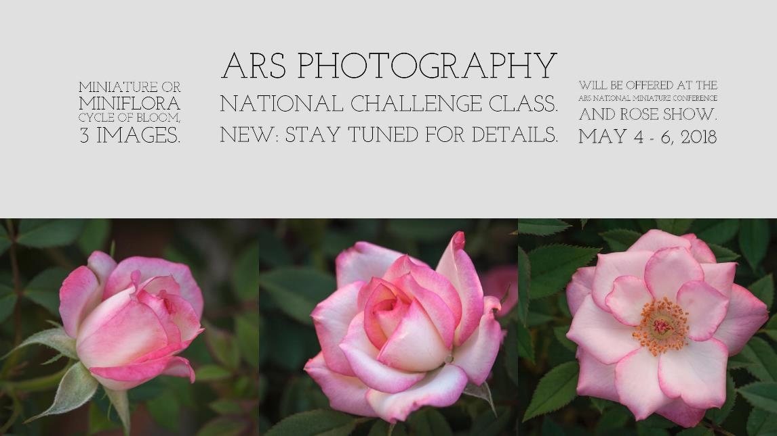
National Challenge Class:
An Example Using ‘Child’s Play’

Slide 36
A Few Things to Keep in Mind
When Applying the New Guidelines
Flexibility in local shows
Creativity in show schedules
Importance of encouraging interest and participation in shows locally, and at District and National levels

Slide 37
Flexibility in Local Shows
A rose photography show can be held without horticulture specimens being present. This does allow flexibility for having photo shows during months when there may not be horticultural specimens available for exhibition.
ALL ARS rose photography shows must be judged by ARS Accredited judges.
The society or district is also encouraged to be creative in their schedule writing, but remain within the rules and guidelines of the ARS in order to offer ARS awards.
The classes listed in Chapter 9 are also suggestions for local shows, but as with horticulture classes, societies are free to make their own classes as long as the scorecard can be applied within each class, and the Rules and Guidelines are followed.
Notes:
Section 7

Slide 38
Writing Show Schedules
The final authority for a rose photography show is its own schedule provided it is not in conflict with ARS rules. If the show schedule is in conflict with the rules governing ARS awards, the judges must decline to give the awards.
It is advisable to have an accredited judge write the show schedule.
All show schedules should contain rules for exhibitors.
It is important to be clear as to the requirements of a class. Terms that are not defined by the Guidelines should be avoided or must be defined in the schedule.
Information regarding intellectual property MUST be included in the schedule.
The ARS Photography Chair and your District Chairman of Photography will be happy to assist you with your Photography Schedules.
Notes:
Section 9-1, Section 9-2

Slide 39
Important Resources
The website of the American Rose Society has information available to both members and nonmembers.
Members have access to the Guidelines for Judging Roses, the Guidelines for Judging Rose Arrangements and the Guidelines and Rules for Judging Rose Photography under Resources.

Slide 40
“If you take a flower in your hand and really look at it, it's your world for a moment.”
~Georgia O’Keeffe

Slide 41
Unattributed quote:
“The Master has failed more times than the Beginner has tried.”
I plan to keep trying…

Slide 42
Wishing you good light and beautiful roses!
Dr Susan Brandt Graham
Albuquerque, New Mexico

Slide 43


